Slide 1
Youngsters PAID INTERNSHIP in GREECE
www.amberjob.eu www.facebook.com/amberjob.eu

Slide 2
Internship places
Luxury 4-5* Hotels;
Located in Greek islands like Kos, Rhodes, Corfu, Crete, Santorini, Zakynthos, Samos, Mykonos and many more... and Cyprus

Slide 3
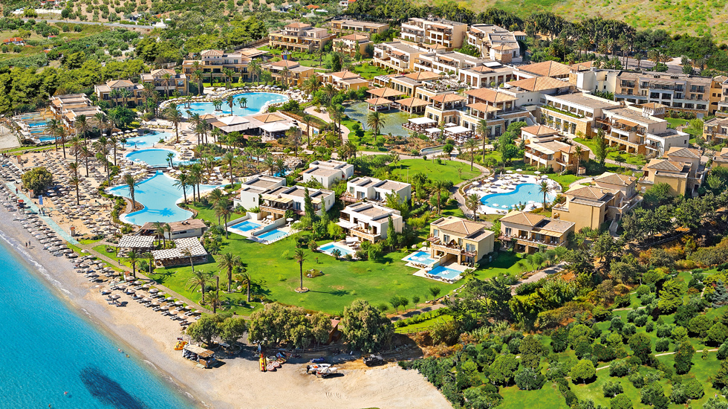

Slide 5
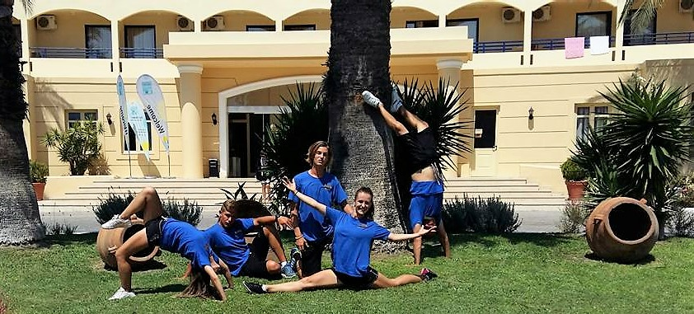
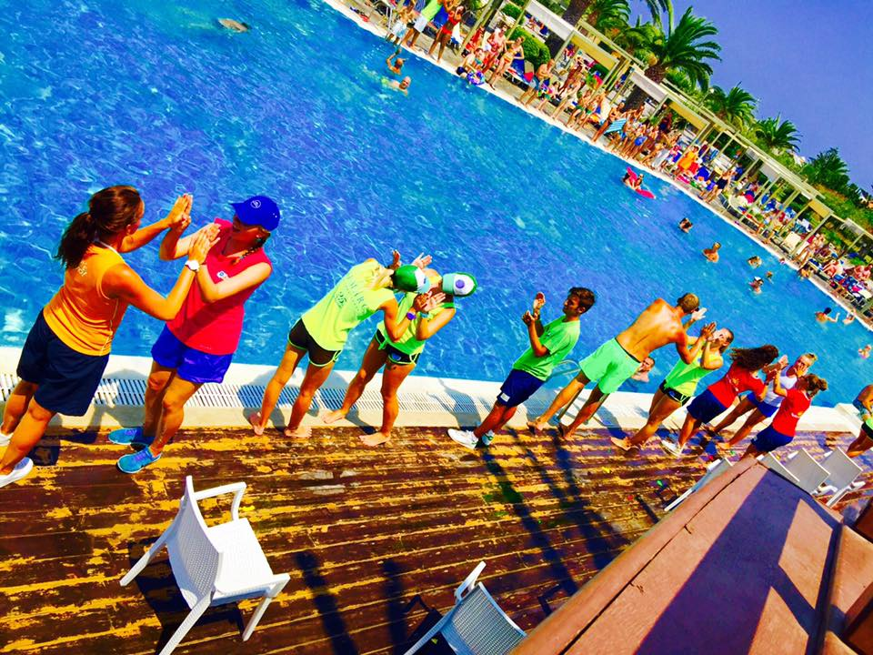
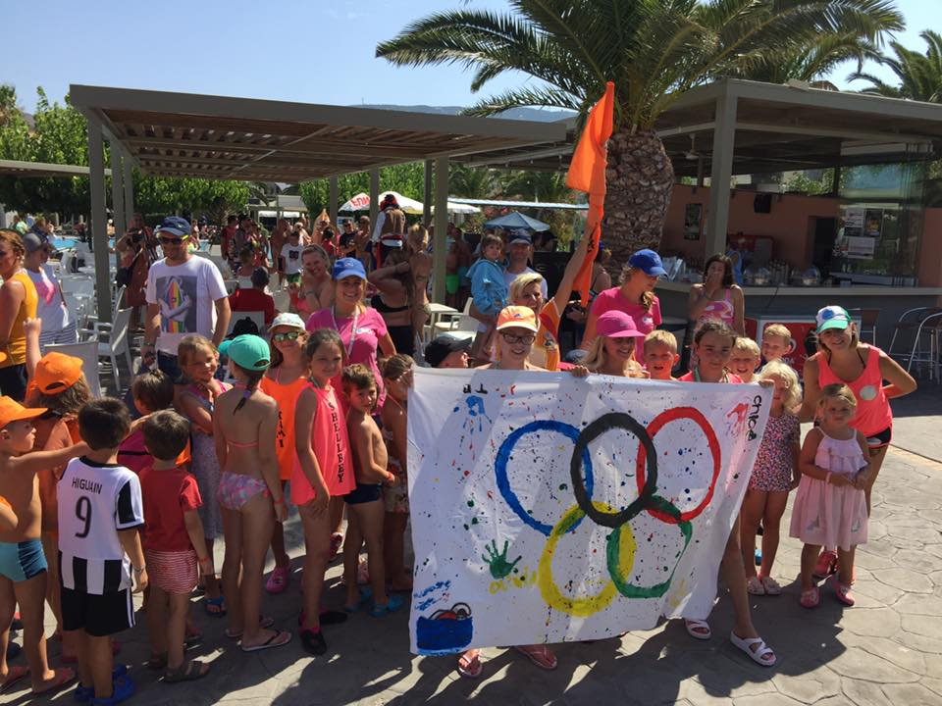
ENTERTAINMENT DEPARTMENT

Slide 6
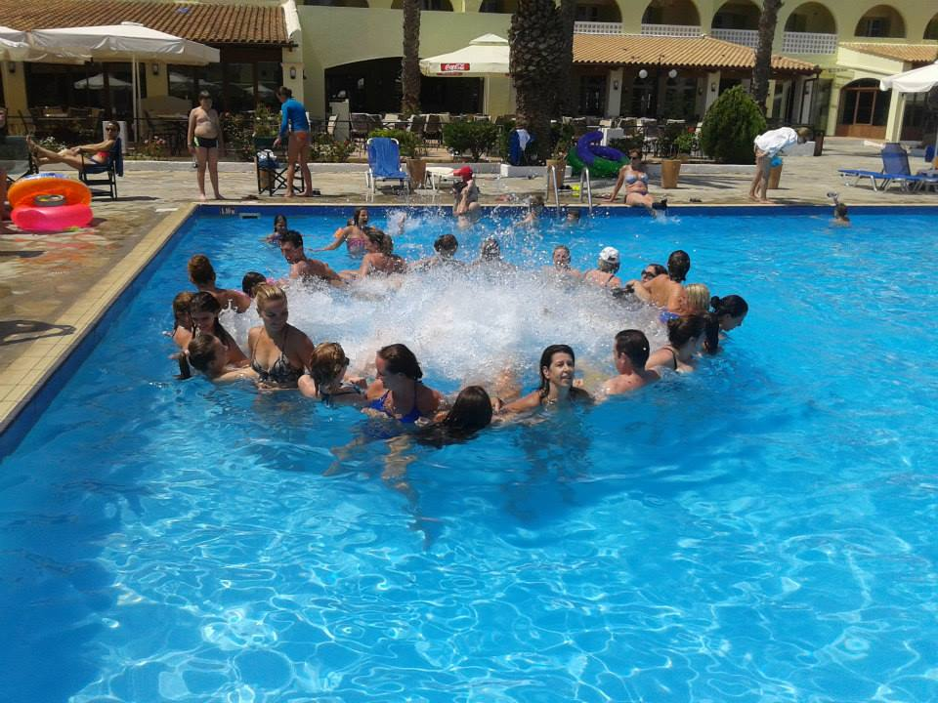
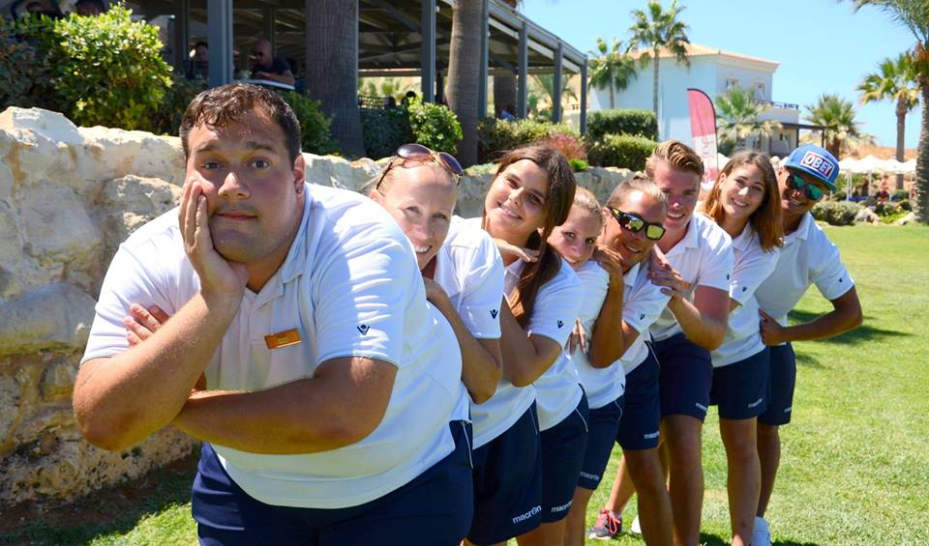
Sport/Fitness events organizer organizing various sport activities and tournaments for hotel guests

Slide 7
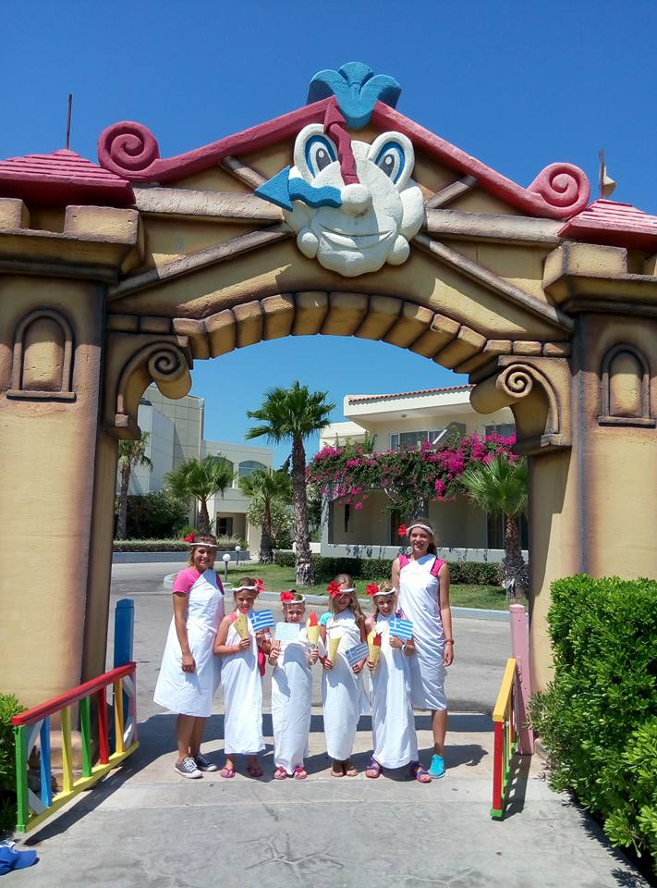
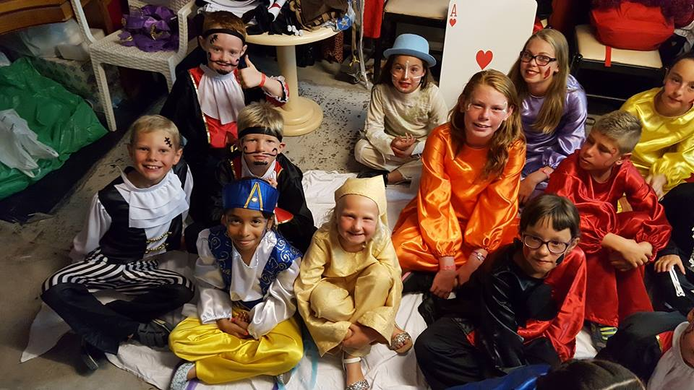
Childcare worker– organizing thematic days and events for smallest hotels guests

Slide 8
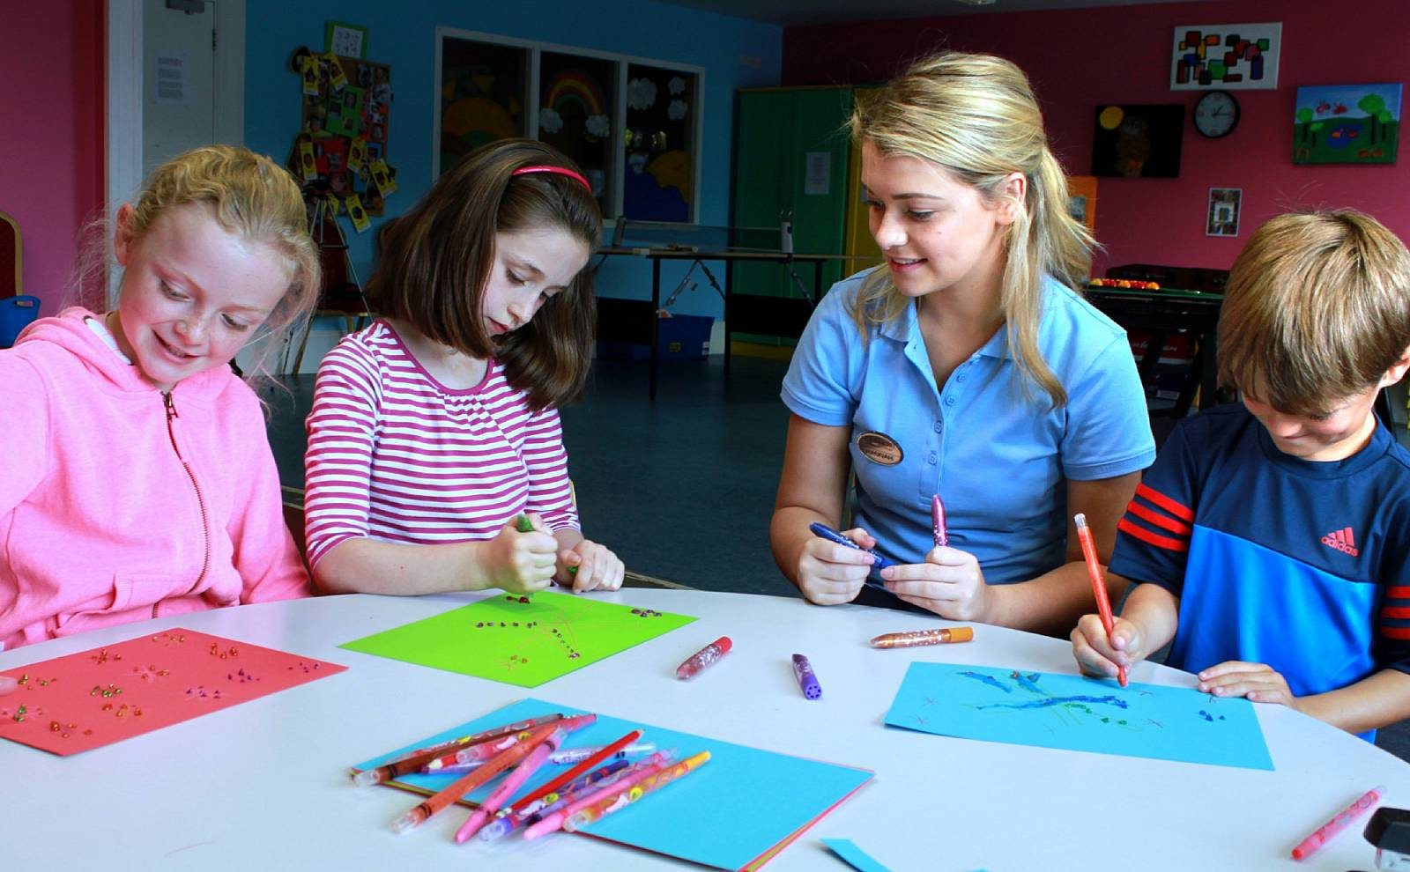
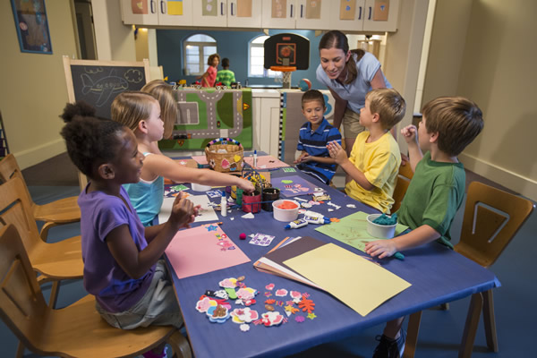
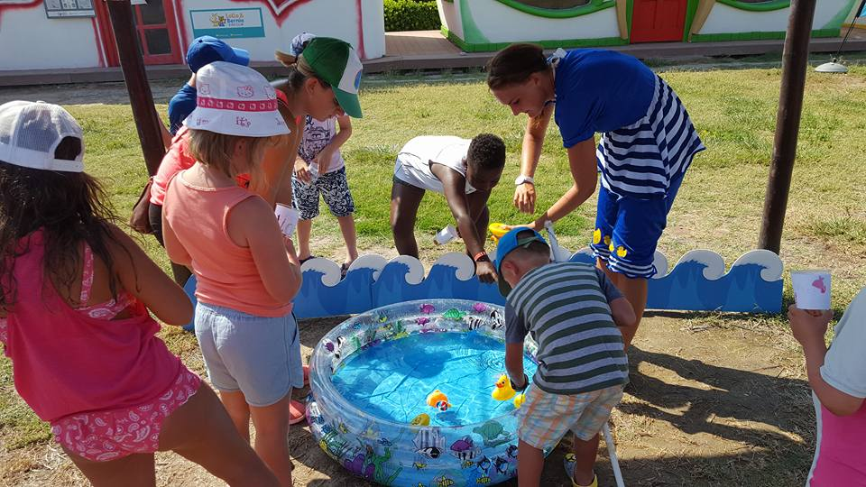
Educational lessons, games, arts, crafts and fun

Slide 9
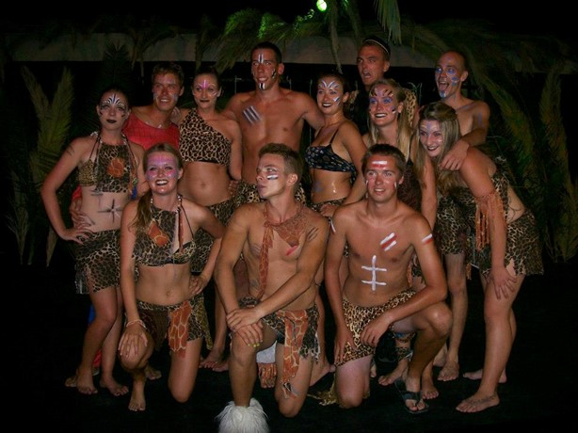
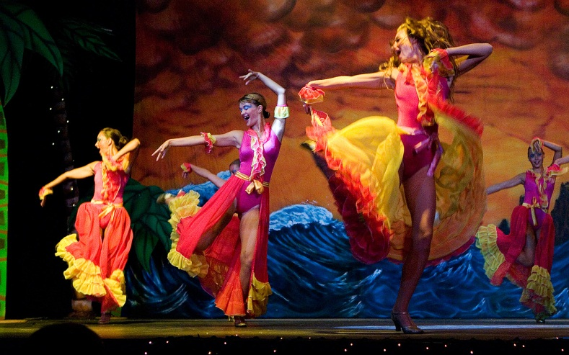
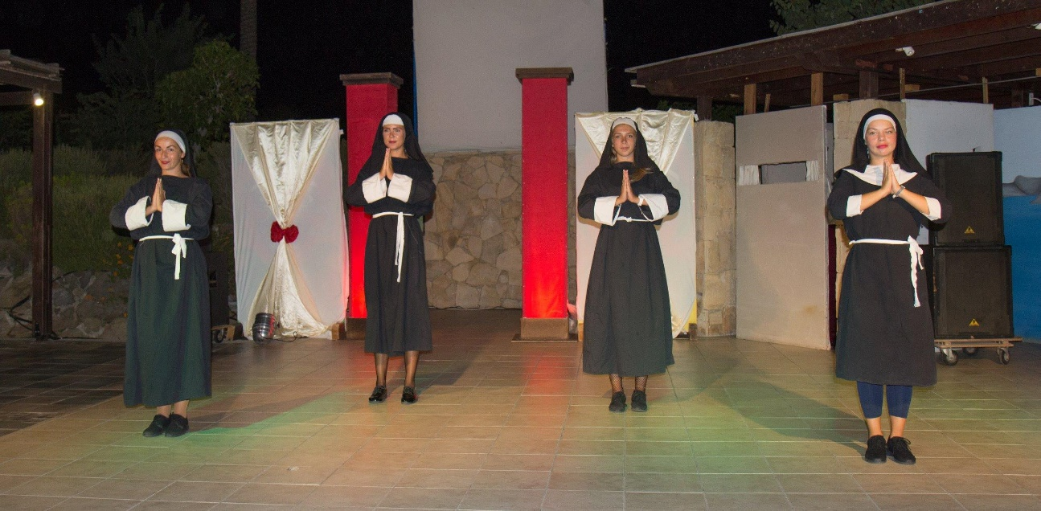
Evening Entertainment – organizing evening shows, performances, internactive games and events.

Slide 10
Working conditions
Practice from 3 months
6 days per week
Available positions for last year students too

Slide 11
Benefits and bonuses
Hotel Scholarship
Free accommodation
3 meals per day
On real job training
Holiday working environment
Official training certificate
New friendship
Foreign language improvement
Combination of work and vacation

Slide 12
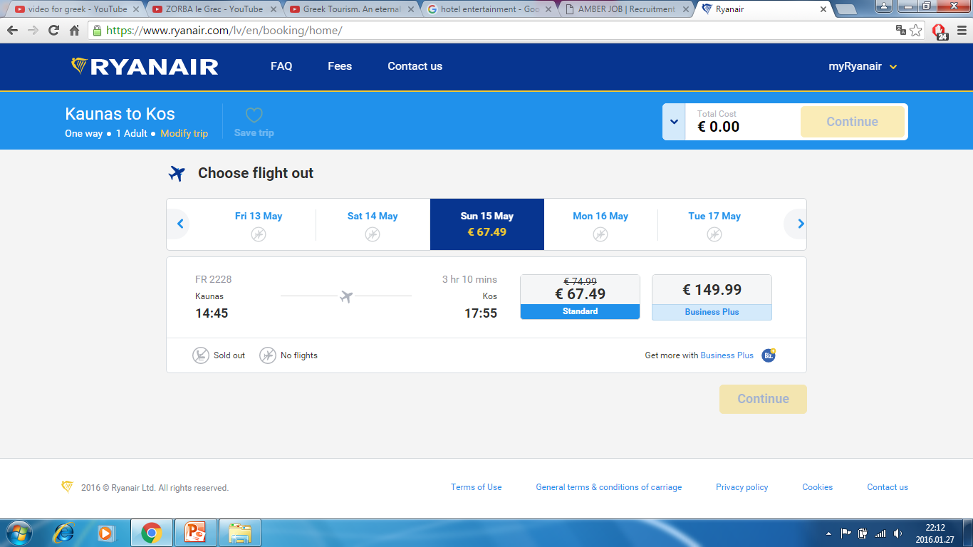
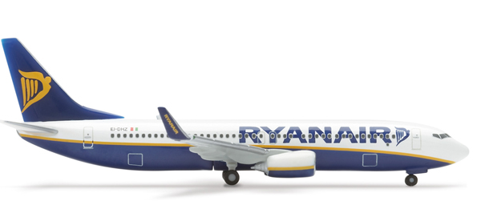
Reaching practice place
Flight tickets to practice place (Ryanair; Wizzair);

Slide 13
Students present:
CV in english with recent picture to
amberjobeu@gmail.com;
Copy of valid passport or
copy of EU resident permit card;
European health insurance card.

Slide 14
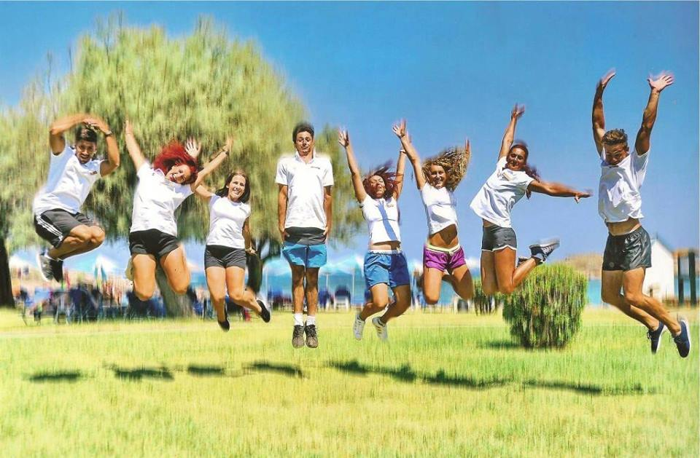
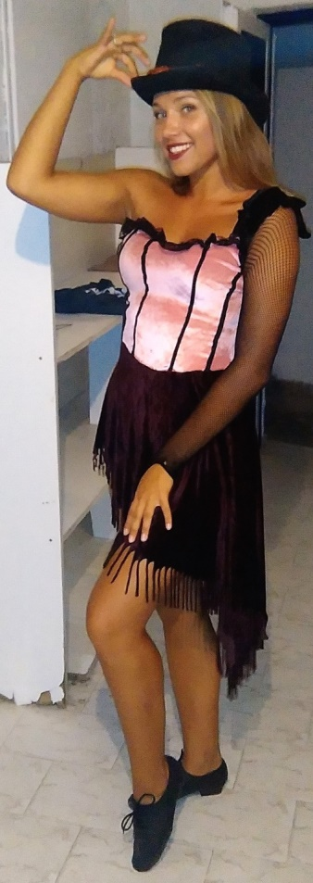
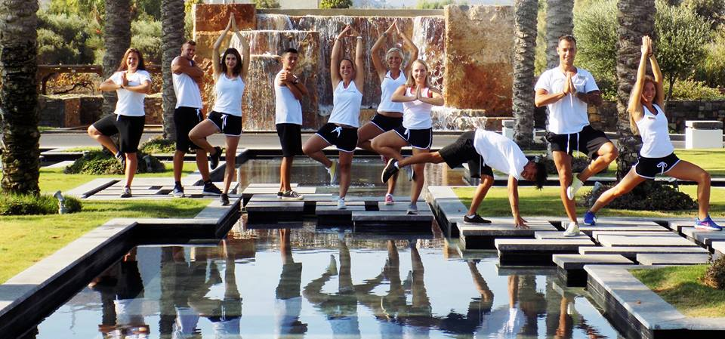
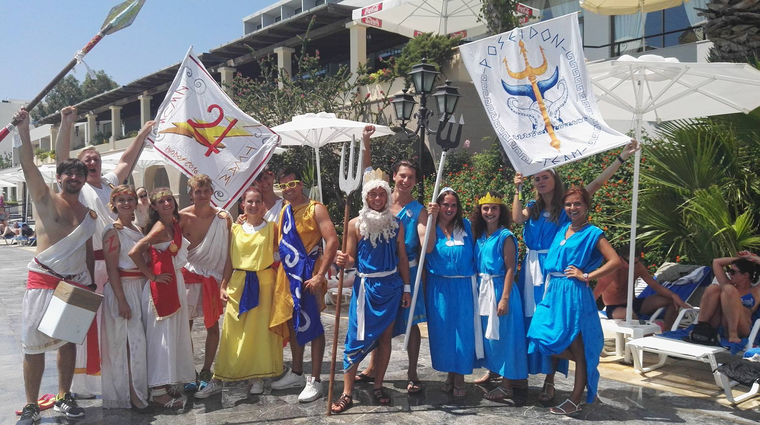
Our students in Greece

Slide 15
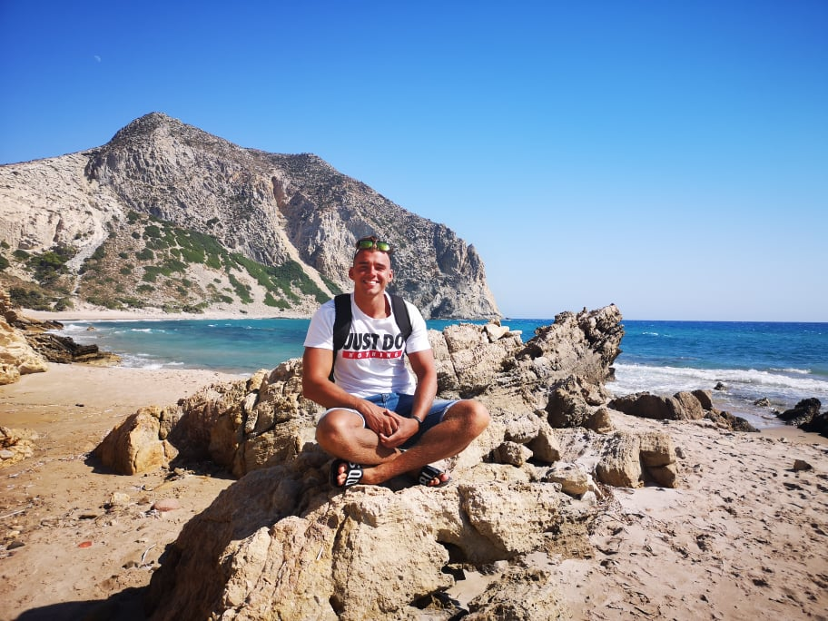
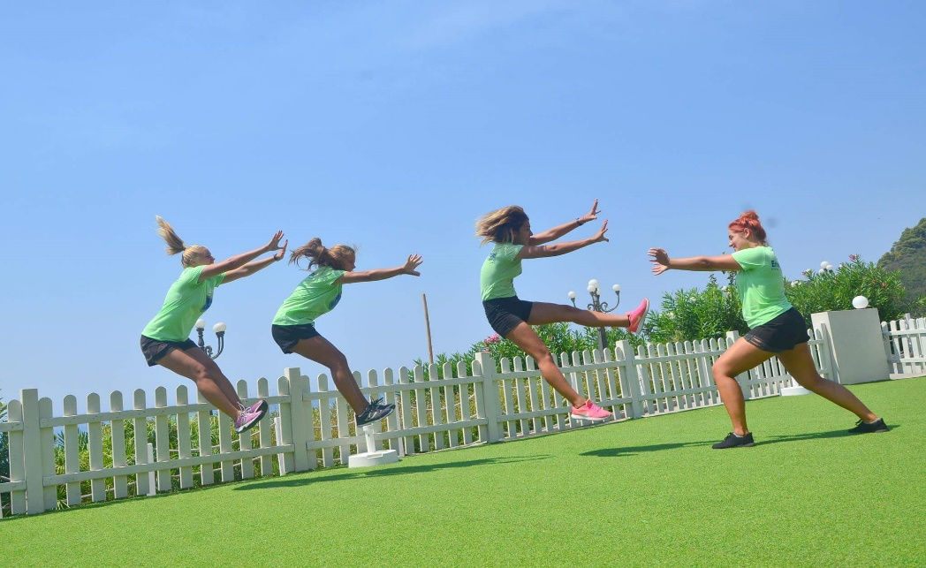
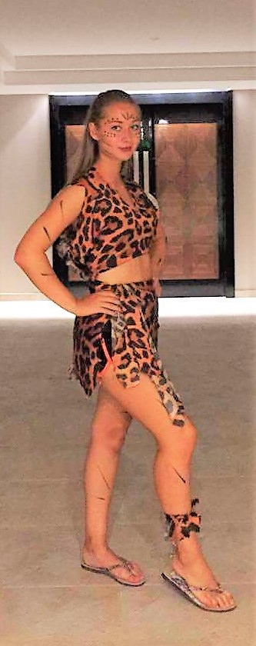
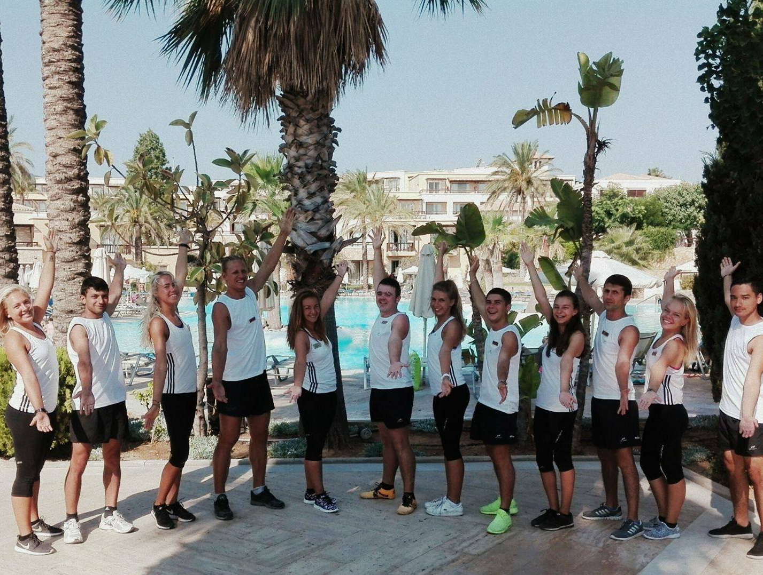

Slide 16
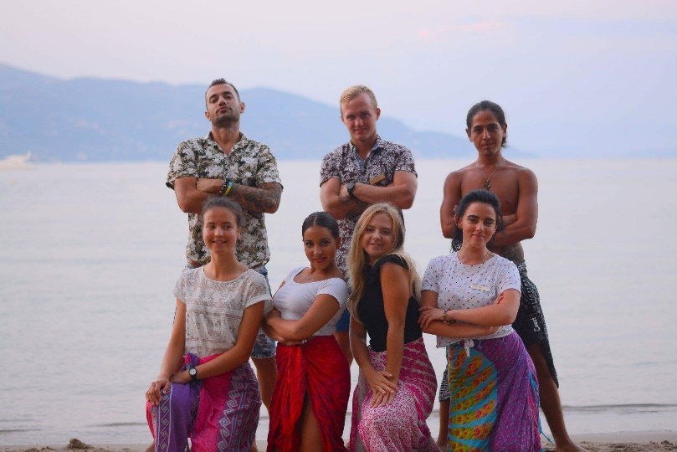
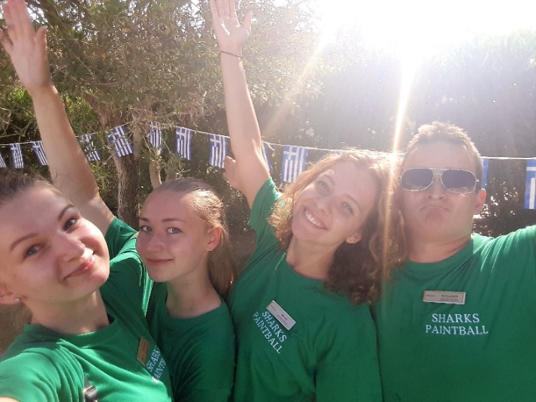
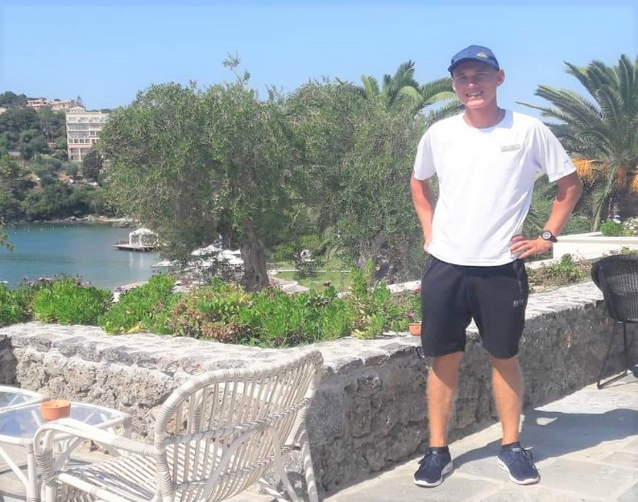
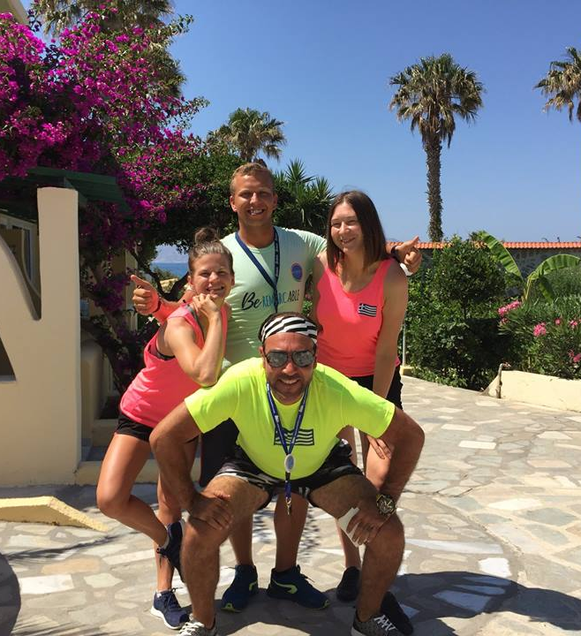
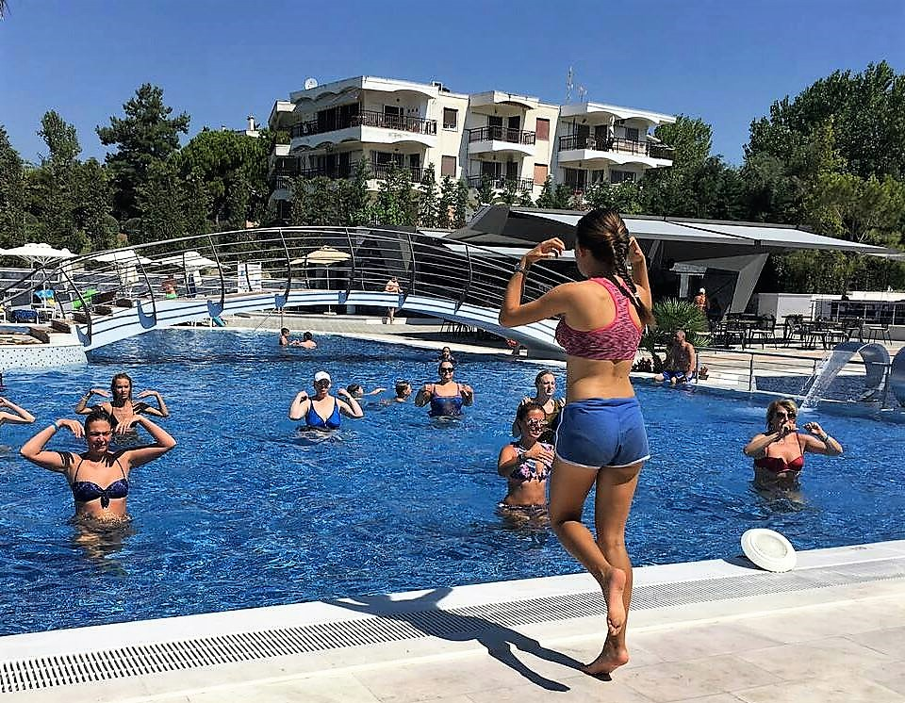
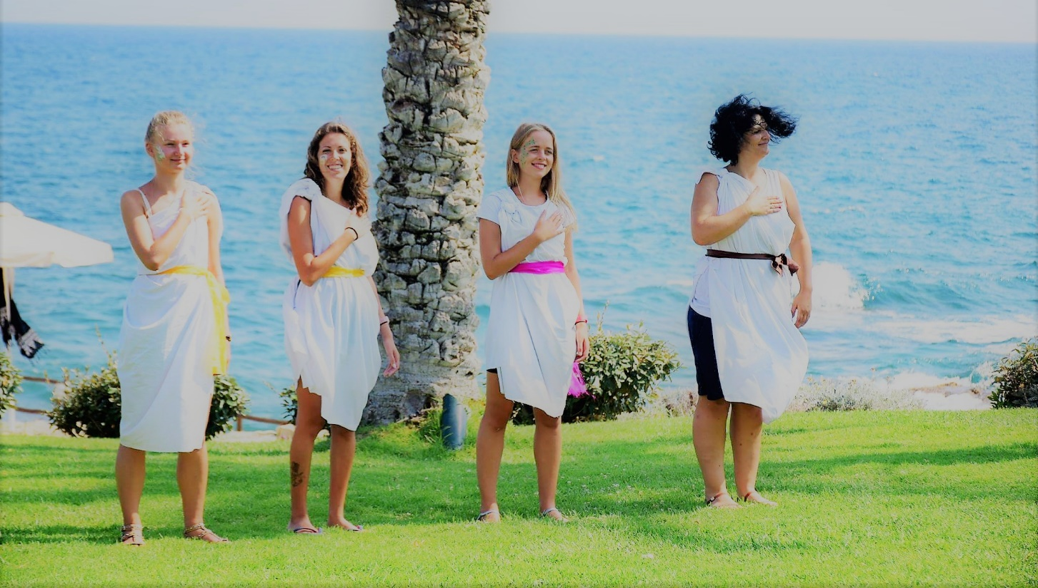

Slide 17
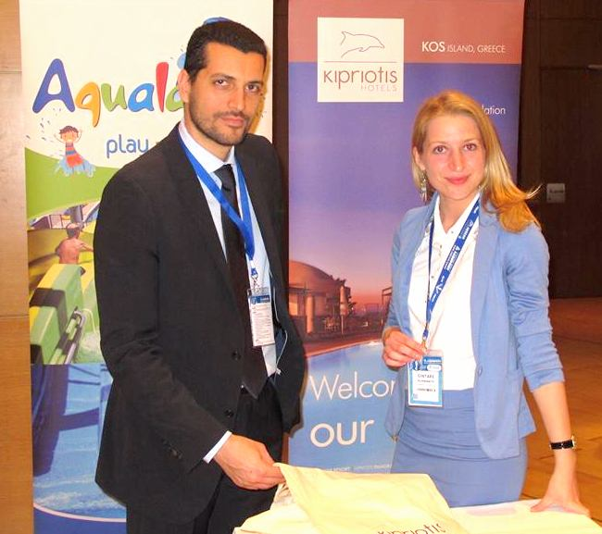
Personal experience
Some of our partners:
Lithuanian Sports University, Kaunas, Lithuania;
Riga State Technical school, Riga, Latvia;
War Studies University, Warsaw, Poland;
University of Applied Sciences (Kauno Kolegija);
Kolping University of Applied Sciences, Kaunas, Lithuania;
University of Applied Social Sciences, Vilnius and Klaipėda, Lithuania
University of Economics and Culture, Riga, Latvia;
Vilnius University, Lithuanian;
Mykolas Riomeris University, Vilnius, Lithuania;
Lithuania Business University of Applied Sciences, Klaipėda, Lithuania
Vilnius Gediminas Technical University;
Vilniaus Kolegija, Lithuania;
Northern Lithuanian College, Šiauliai, Lithuanian
Etc…

Slide 18
INTERVIEW DATES FOR 2020
18 of March in Vilnius, Lithuania
19 of March in Klaipėda, Lithuania
20 of March in Kaunas, Lithuania
16 of March in Riga, Latvia
17 of March in Daugavpils, Latvia

Slide 19
Do not wait apply now !
www.amberjob.eu
amberjobeu@gmail.com
+370 67603174
www.facebook.com/amberjob.eu
Amberjobeu

Slide 20
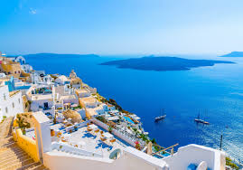
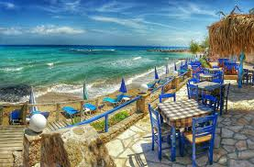
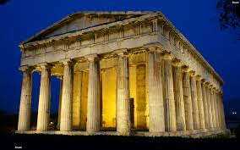
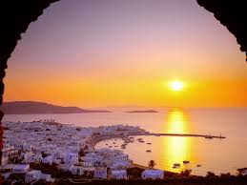
Life is an open book full of white pages. You write the story as you go.

